Slide 1

PROJECT TITLE EMPLOYEE MANAGEMENT SYSTEM (EM-SYSTEM) Project Presentation
Industrial training (CSE599) B.Tech
Degree :BACHELOR OF TECHNOLOGY (CSE)
Project Guide:
Mr. Shambhu Bharadwaj
SUBMITTED BY:
Paras Jain(TCA2011006)
Shivang Sharma (TCA2011009)
FACULTY OF ENGINEERING & COMPUTING SCIENCES
TEERTHANKER MAHAVEER UNIVERSITY, MORADABAD

Slide 2

Team Details
Student Name | Role
1.) Paras Jain | Developer, Testing etc.
2.) Shivang Sharma | Developer, Testing etc.
Guidelines: Mention Team Names & their role in project
2
T011A/ Template Version 5.0

Slide 3
Project Brief
The project EMPLOYEE MANAGEMENT SYSTEM is a software based application that allows the administrator to handle all the personal data of each and every employee’s quickly and safely. Using Interactive TUI anyone can quickly learn to use the complete system. EMPLOYEE MANAGEMENT SYSTEM. Using this, the administrator doesn’t have to sit and manage the entire activities on paper, and at the same time, the head will feel comfortable to keep check of the whole system. This system will give him flexibility to manage the entire system from a single online portal.
This project consists of Java Program for Employee Management System. In this project I have created a TUI program for Employee Management System which consists of 4 different operation’s -
(1) Adding Employee
(2) Removing Employee
(3) Updating Employee
(4) Viewing details of Employee
Guidelines: Mention brief about the project and it’s functions/ modules
3
T011A/ Template Version 5.0

Slide 4
Project Brief
The objective of “Employee Management System” is designing a scheduling system for a work center. Employee Management System is a distributed application, developed to maintain the details of employees working in any organization. It maintains the information about the personal details of their employees.
This system improves the method of maintaining and managing employee’s personal details such as
Name
Father’s name
Employee's ID
Employee's Email ID
Employee's Position
Enter Employee contact Info
Enter Employee's Salary
Guidelines: Mention brief about the project and it’s functions/ modules
4
T011A/ Template Version 5.0

Slide 5
Methodologies/ Technologies/ Tools to be used
Operating System : Linux, Ubuntu, Mac, Windows XP, 7, 8, 8.1, 10, 11
Frontend : IntelliJ IDEA
Backend : JAVA
5
T011A/ Template Version 5.0

Slide 6
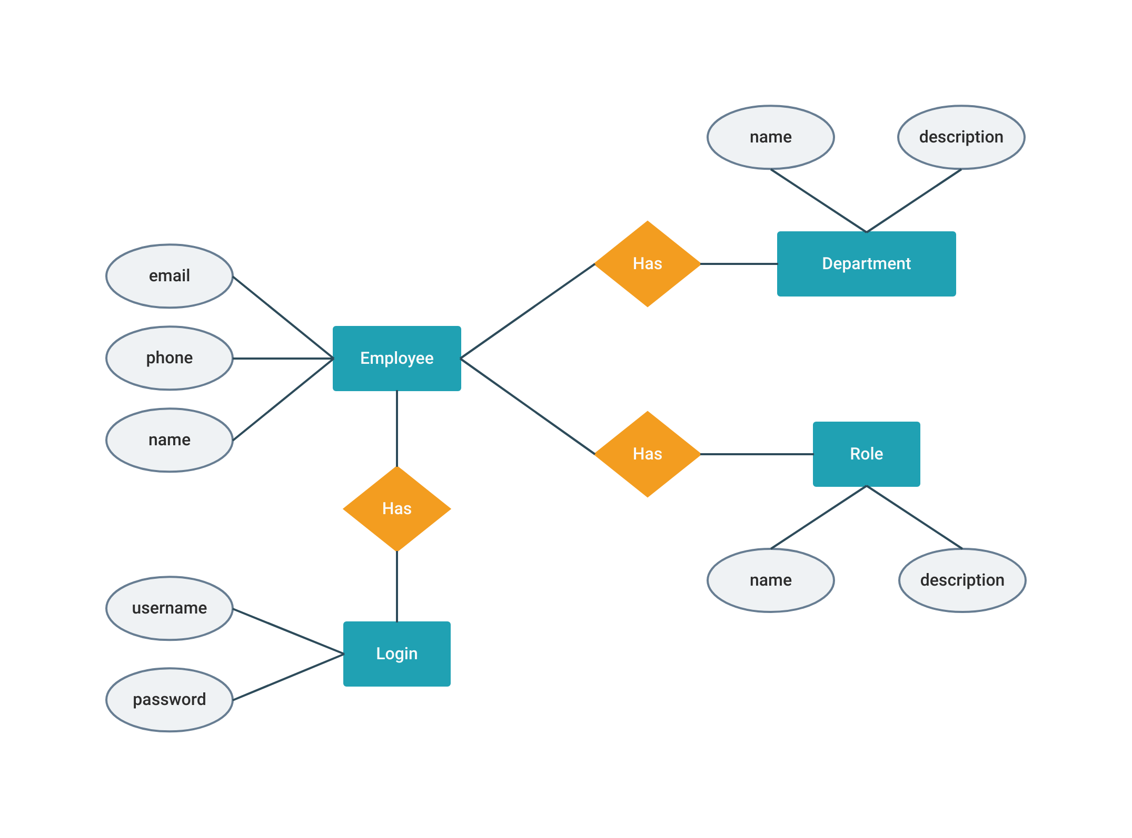
Entity Relationship Diagram (ERD)
6
T011A/ Template Version 5.0

Slide 7
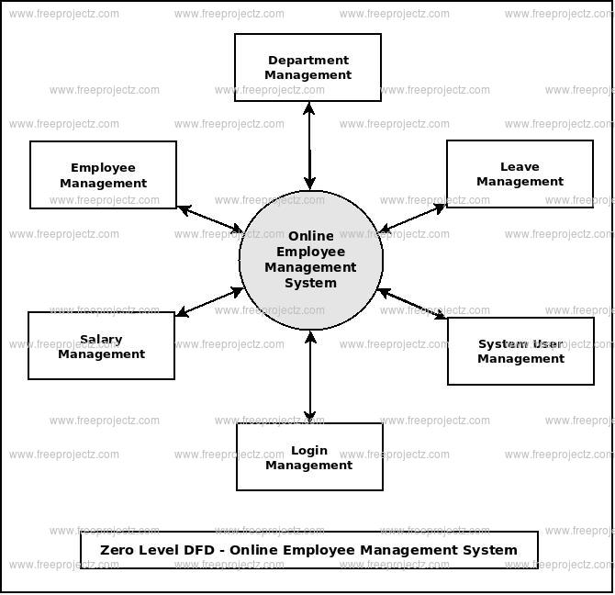
Data Flow Diagram (DFD)
Guidelines: Add more slides, if required to show all DFDs
7
T011A/ Template Version 5.0

Slide 8
Flow Chart
EMS
ADD Employee
See Employee Details
Remove Employee
Update Employee details
EXIT Portal
Guidelines: This slide is optional
8
T011A/ Template Version 5.0

Slide 9
Use Case Diagram
ADD Employee
Check Employee
Details
Admin
Employee
Remove Employee
Update Employee Details
EXIT Portal
Guidelines: This slide is optional. May add more slide, if the details are available
9
T011A/ Template Version 5.0

Slide 10
\
Advantage of The Project
Efficiency And Better Accuracy
Fewer Compliance Risks
Boosted Profitability
Very Few Manual Errors
Higher Productivity
Higher Motivation
Lower Costs
Backup of data
No paper work
Reliable
Convinence
Guidelines: Mention advantage from this project, the audience/ users who will get benefitted
10
T011A/ Template Version 5.0

Slide 11
References, if any
1.) https://www.javatpoint.com/java-tutorial
2.) https://www.youtube.com/watch?v=WRQGCtcuuhw
11
T011A/ Template Version 5.0

Slide 12
THANKS

